Slide 1
Website Redesign for Zomato
344

Slide 2
Contents
Introduction
Website structure
Header
Section 1
Section 2
Section 3
CSS Styling
Conclusion

Slide 3
Website Structure

Slide 4
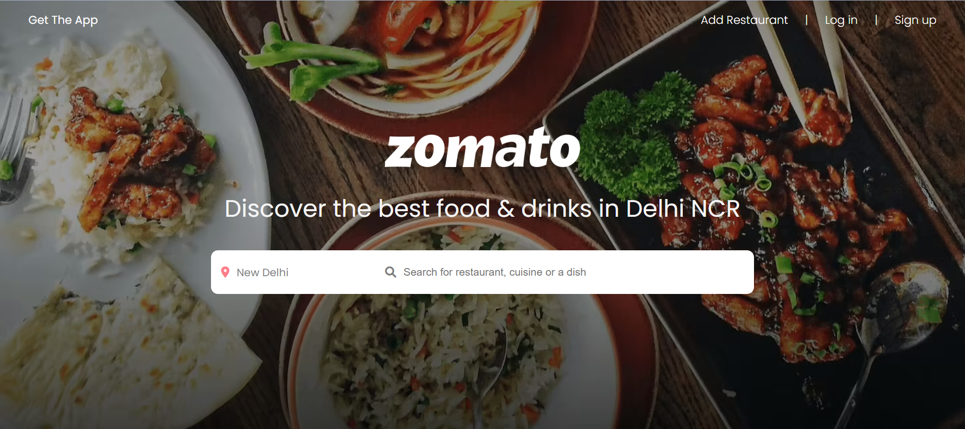
Header
The header section of the website includes the following key elements:
Navigation Bar: Located at the top, the navigation bar includes links for "Get the App," "Add Restaurant," "Log in," and "Sign up."
Logo: The Zomato logo is prominently displayed in the header.
Heading: Beneath the logo, there is a heading that reads "Discover the best food & drinks in Delhi NCR."
Search Bar: A user-friendly search bar allows users to search for restaurants, cuisines, or dishes. It includes a location dropdown and a text input field.

Slide 5
Sections
Section 1- Feature Highlights
Order Food Online: An image and description encourage users to order food online.
Dining Out: Another image and description prompt users to dine out.
Nightlife & Club: An image and description target users interested in the nightlife scene.
Section 2 - Localities
This section provides details about popular localities in and around Delhi NCR. It includes locality names and the number of places available in each locality.
Section 3 - Get the Zomato App
This section focuses on encouraging users to download the Zomato app. It includes an image of the app, a heading, a brief description, and links to download the app from the Google Play Store and Apple App Store.

Slide 6
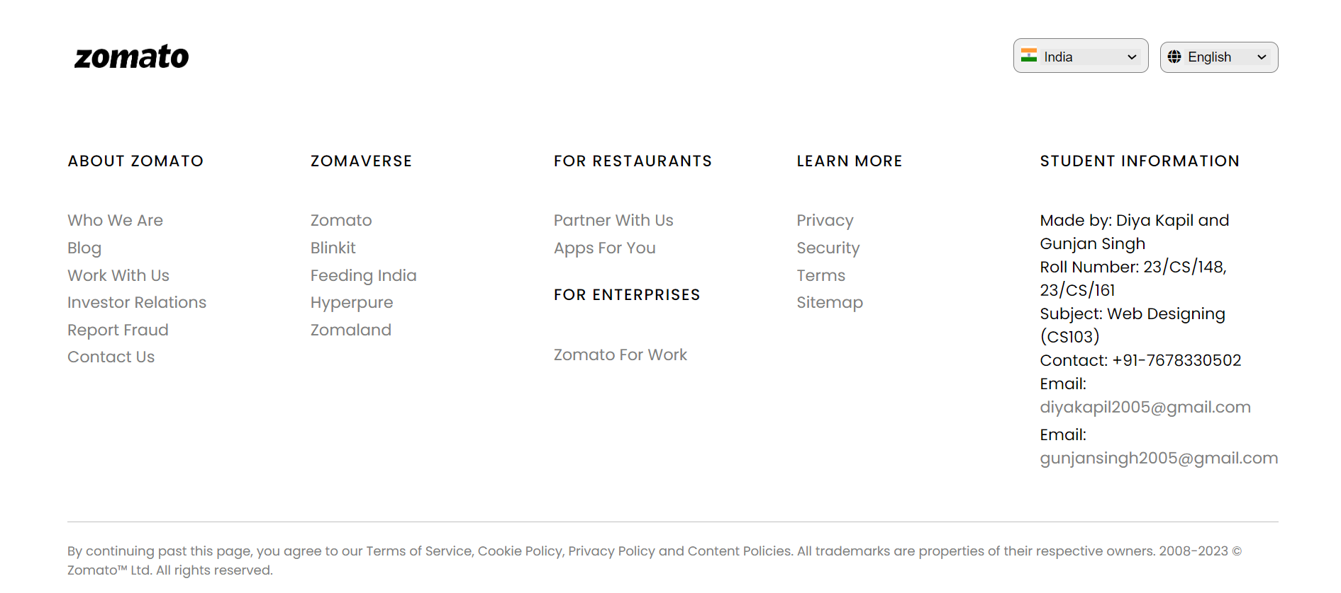
Footer
The website's footer is divided into several sections:
Section 1: Displays the Zomato logo and language selection buttons (country and language).
Navigation Container: Contains multiple link containers with links to different sections of the website.
Social Media Icons: While the code for social media icons exists, it is currently commented out and not displayed on the website.
Student Information: Contains information about the website's creators, including their names, roll numbers, the subject of the project, contact details, and email addresses.

Slide 7
CSS Styling

Slide 8
The CSS styling in the Zomato project is characterized by a modern and clean design. It utilizes the 'Poppins' font-family for text, providing a sleek and readable appearance.
The header includes a top navigation bar that is horizontally aligned. The "Get The App" link stands out with its color, encouraging users to download the Zomato app.
The header features a full-height viewport with navigation links, while the search bar offers user-friendly input options.

Slide 9

Section 1 contains three clickable images and labels.
Each section-1-item is a card-like element with rounded corners, a white background, and a subtle box shadow.
On hover, these items grow in size, creating a visual effect to indicate interactivity.
The images are set to a fixed size and have rounded corners.

Slide 10
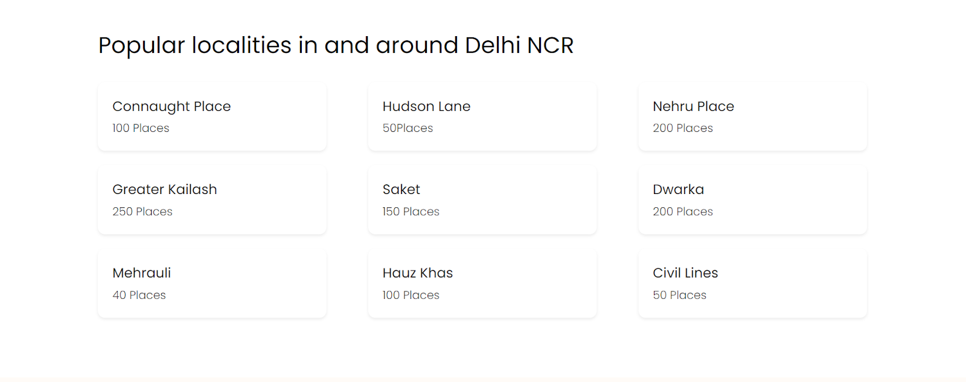
Section 2 presents a list of popular localities.
The locality items are styled as cards with rounded corners and a box shadow.
On hover, these items also feature a subtle transformation with a stronger box shadow and increased size.

Slide 11
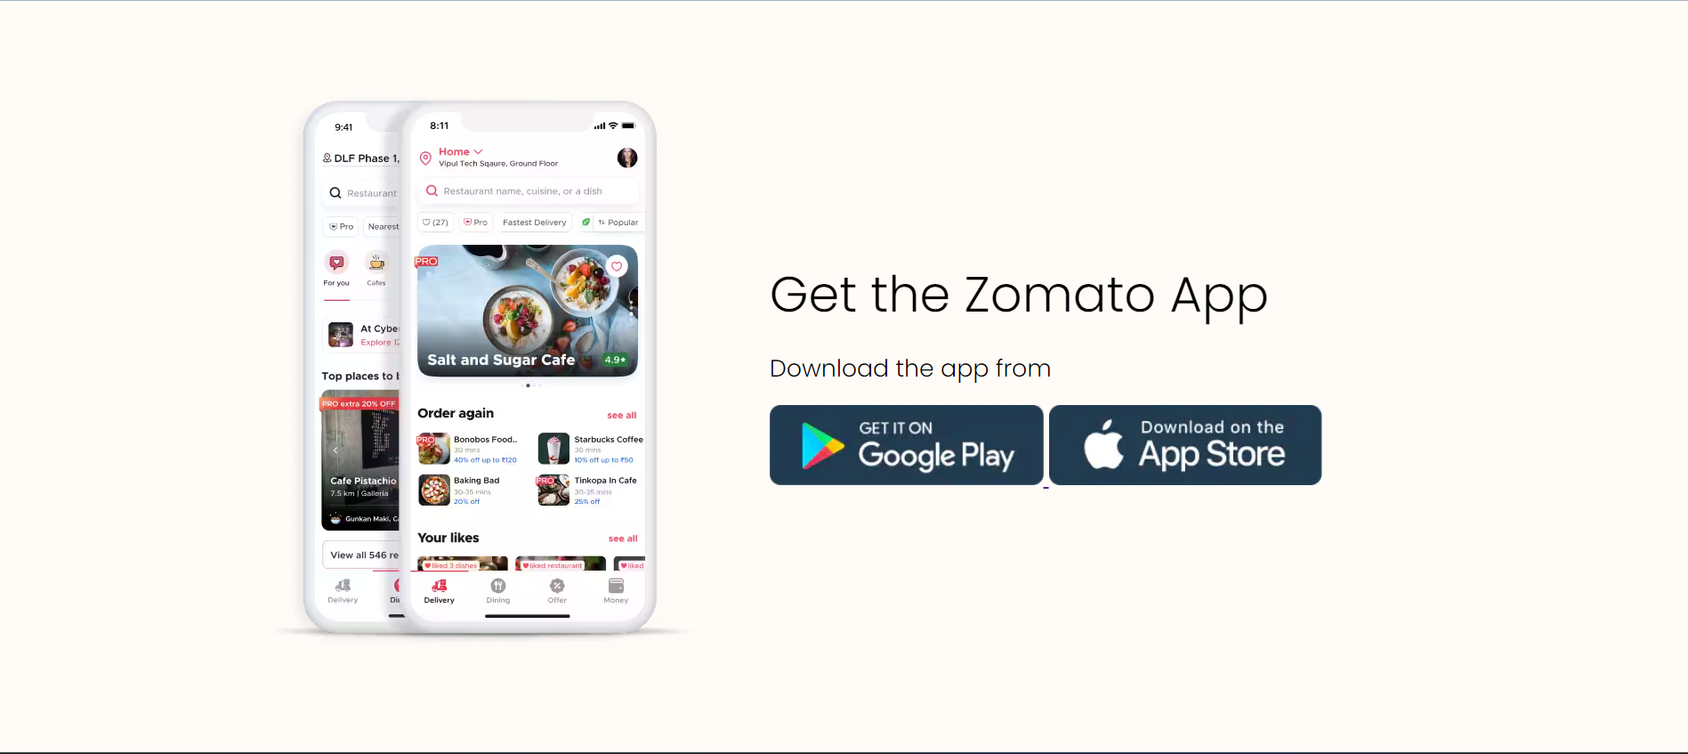
Section 3 emphasizes downloading the Zomato mobile app.
It includes an image on the left and content on the right.
The Zomato app image has a fixed width.
The content features a headline and a description.
App download buttons are styled with specific dimensions and spacing.

Slide 12
The footer section is structured into columns with specific styling.
The footer logo and navigation buttons are organized with appropriate padding and margins.
Links in the footer change appearance on hover.
Social media icons are included but are currently commented out in the code.

Slide 13
Conclusion
This Zomato project aims to offer a visually appealing, user-friendly, and informative platform for discovering restaurants in Delhi NCR. Its design and features are geared towards enhancing the user's ability to find, explore, and enjoy various culinary experiences. The project demonstrates a commitment to a seamless and satisfying user experience while showcasing the diverse dining options available in the region.

Slide 14
Thank you for paying attention!(if you did)
Presented by:
Diya Kapil
(23/CS/148)
Gunjan
(23/CS/161)

